Slide 1
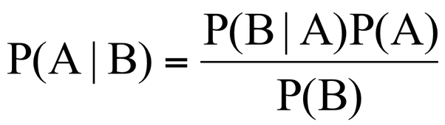
BAYES’ THEOREM

Slide 2
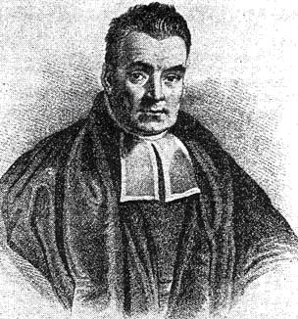
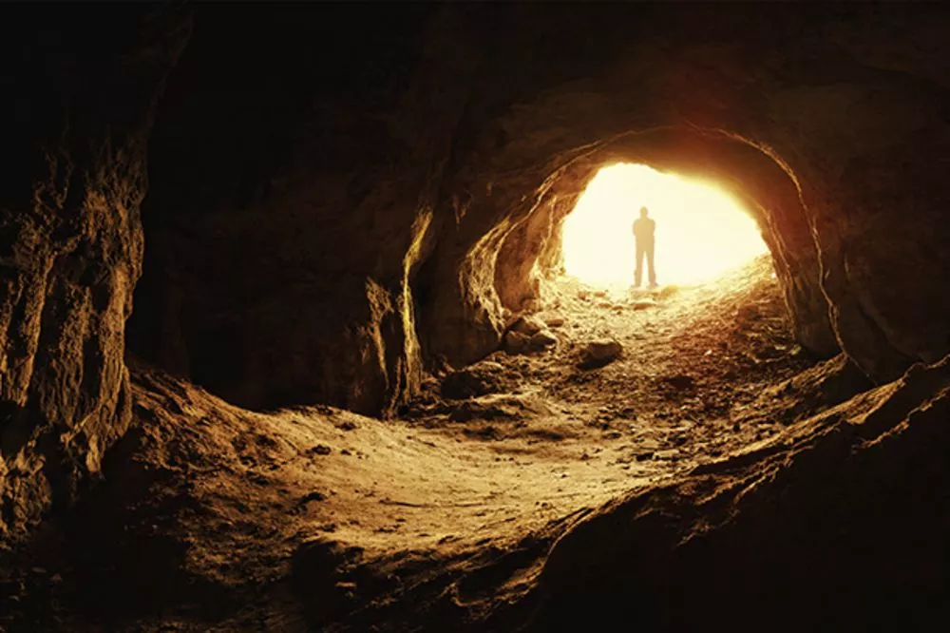
INTRODUCTION
Invented in the 18th century by English mathematician, Thomas Bayes
Inspired by a thought experiment
Richard Price introduced it with an analogy
Thomas Bayes
1701 - 1761
Notes:
He didn’t think it was revolutionary
Didn’t submit it to the Royal Society despite being a member
Discovered after he died (like a decade)
Richard Price discovered Bayes Theorem
Thought exp-throwing a ball
Analogy-caveman

Slide 3

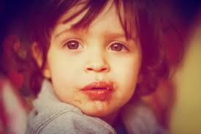
Useful tool for calculating conditional probabilities
Key understanding to think rationally
Refers to as logical thinking
Has many applications

Slide 4
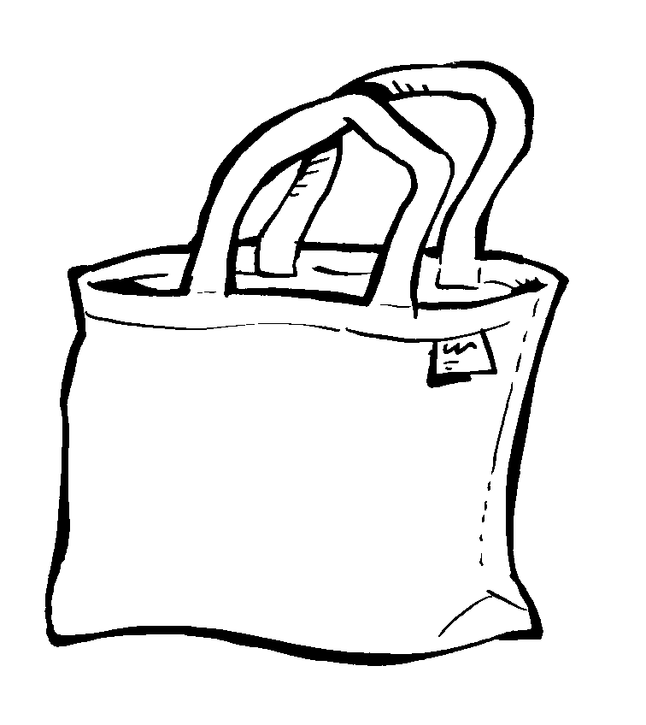
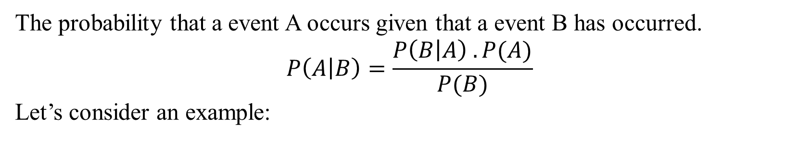



WHAT DOES IT SAY?
The probability that a event A occurs given that a event B has occurred.
$$P\left(A | B\right)=\frac{P\left(B | A\right) . P(A)}{P(B)}$$
Let’s consider an example:
$$B_{1}$$
$$B_{2}$$
$$B_{3}$$

Slide 5

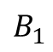
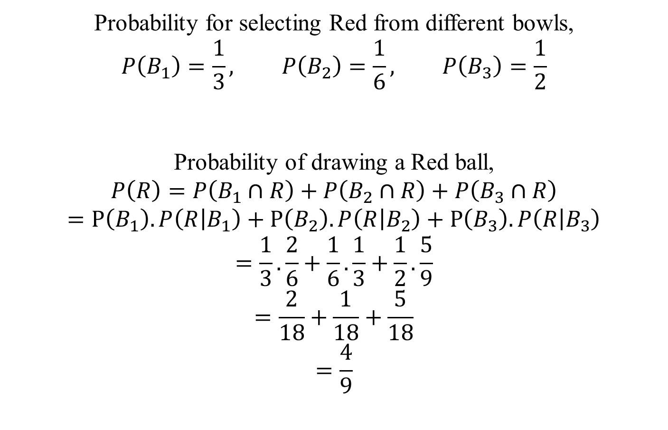


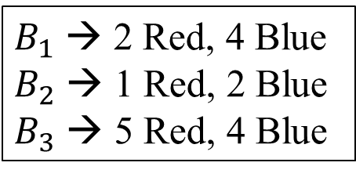



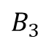



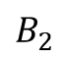
$B_{1}$ → 2 Red, 4 Blue
$B_{2}$ → 1 Red, 2 Blue
$B_{3}$ → 5 Red, 4 Blue
Probability for selecting Red from different bowls,
$$P\left(B_{1}\right)=\frac{1}{3}, P\left(B_{2}\right)=\frac{1}{6}, P\left(B_{3}\right)=\frac{1}{2}$$
Probability of drawing a Red ball,
$$P\left(R\right)=P\left(B_{1}∩R\right)+P\left(B_{2}∩R\right)+P\left(B_{3}∩R\right)$$
$$=P\left(B_{1}\right).P\left(R | B_{1}\right)+P\left(B_{2}\right).P\left(R | B_{2}\right)+P\left(B_{3}\right).P\left(R | B_{3}\right)$$
$$=\frac{1}{3}.\frac{2}{6}+\frac{1}{6}.\frac{1}{3}+\frac{1}{2}.\frac{5}{9}$$
$$=\frac{2}{18}+\frac{1}{18}+\frac{5}{18}$$
$$=\frac{4}{9}$$
R
$$\frac{2}{6}$$
$$\frac{4}{6}$$
$$B_{1}$$
B
$$\frac{1}{3}$$
R
$$\frac{1}{3}$$
$$\frac{1}{6}$$
$$\frac{2}{3}$$
$$B_{2}$$
B
$$\frac{5}{9}$$
R
$$\frac{1}{2}$$
$$\frac{4}{9}$$
B
$$B_{3}$$

Slide 6
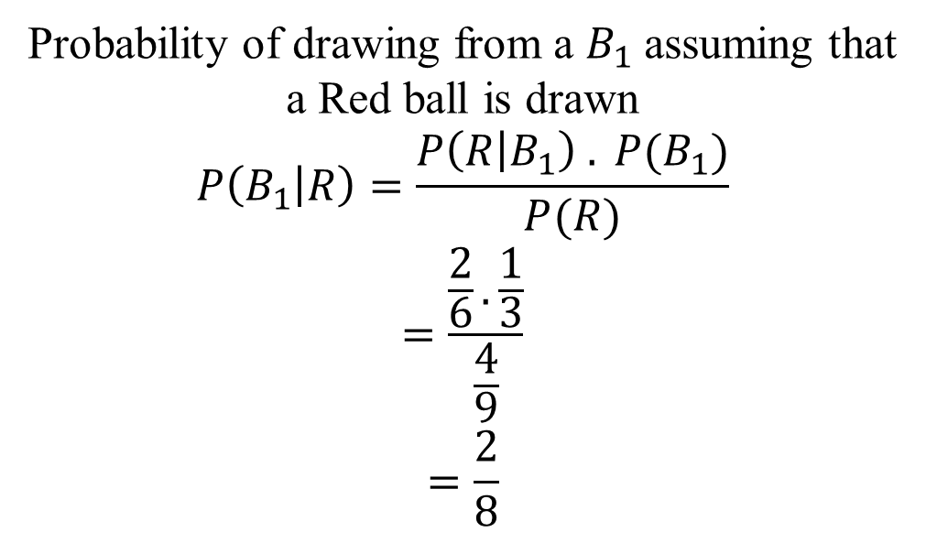
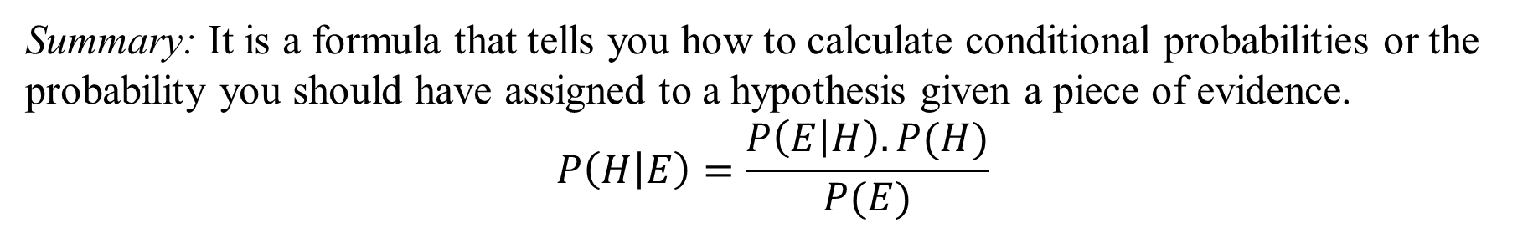

Probability of drawing from a $B_{1}$assuming that a Red ball is drawn
$$P\left(B_{1} | R\right)=\frac{P\left(R | B_{1}\right) . P(B_{1})}{P(R)}$$
$$=\frac{\frac{2}{6}.\frac{1}{3}}{\frac{4}{9}}$$
$$=\frac{2}{8}$$
$$B_{3}$$
Summary: It is a formula that tells you how to calculate conditional probabilities or the probability you should have assigned to a hypothesis given a piece of evidence.
$$P\left(H | E\right)=\frac{P\left(E | H\right).P(H)}{P(E)}$$

Slide 7
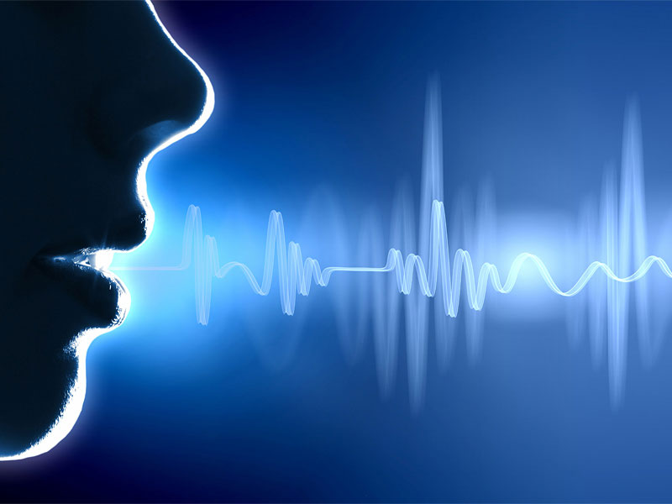

BAYES-BASED CONFIDENCE MEASURE IN SPEECH RECOGNITION

Slide 8
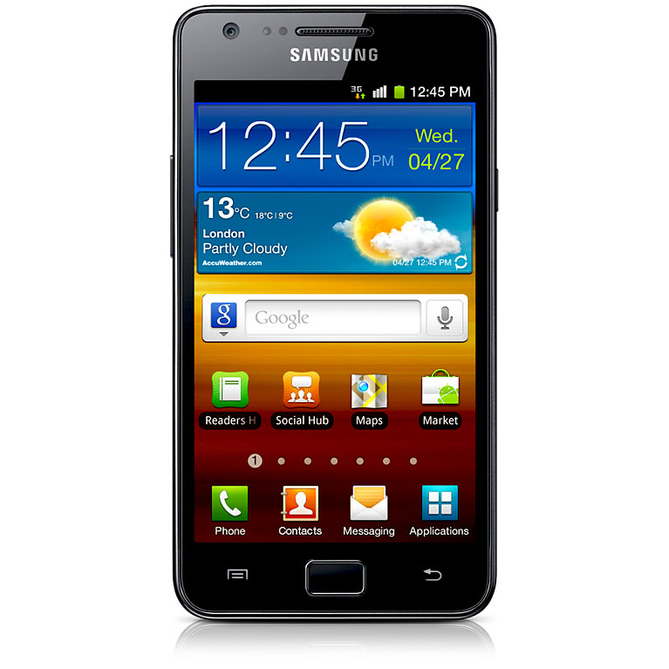

Asked questions like:
Which movie?
Which Area?
What Time?
Automatic speech
recognition (ASR)
Likelihood List
Spanish Movies DB

Slide 9
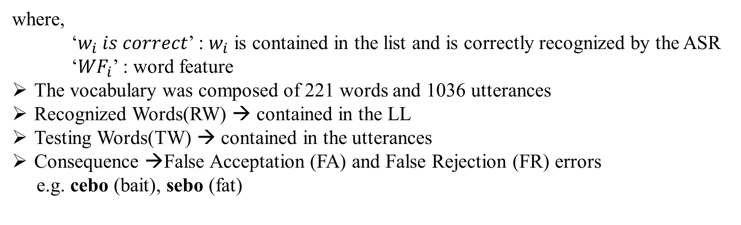
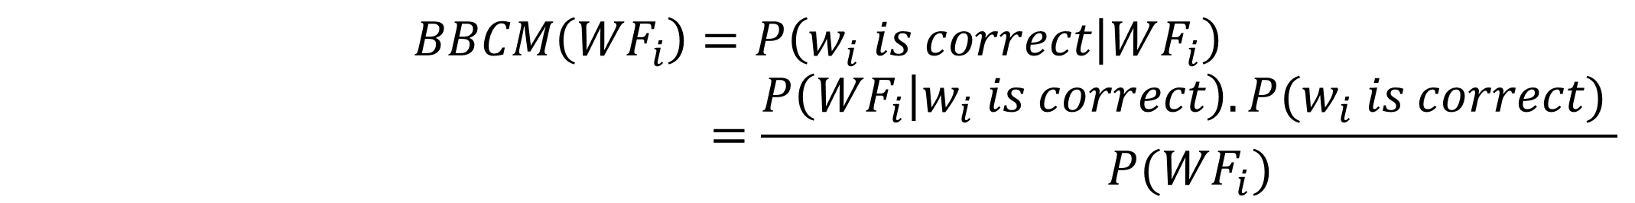
Bayes-based Confidence Measure (BBCM)
$$BBCM\left({WF}_{i}\right)=P\left(w_{i} is correct | WF_{i}\right)$$
$$=\frac{P\left({WF}_{i} | w_{i} is correct\right).P(w_{i} is correct) }{P({WF}_{i})}$$
where,
‘$w_{i} is correct$’ : $w_{i}$ is contained in the list and is correctly recognized by the ASR
‘${WF}_{i}$’ : word feature
The vocabulary was composed of 221 words and 1036 utterances
Recognized Words(RW) → contained in the LL
Testing Words(TW) → contained in the utterances
Consequence →False Acceptation (FA) and False Rejection (FR) errors
e.g. cebo (bait), sebo (fat)

Slide 10

RESULTS
Errors were much more distinguishable.
Provides a discriminative ability 92% higher than other algorithms e.g. cebo (bait), sebo (fat)

Slide 11

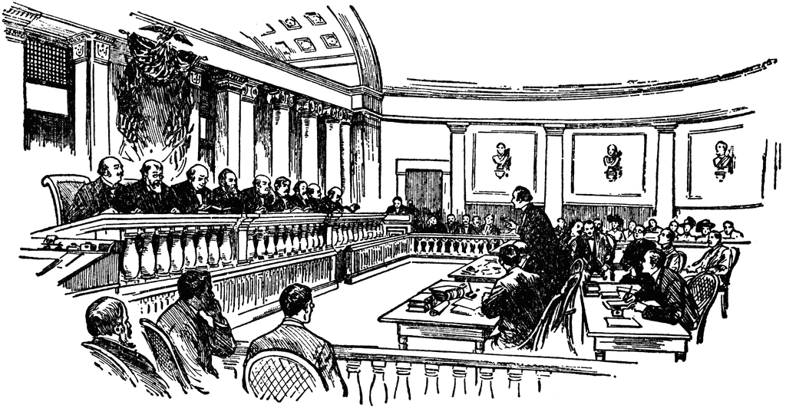
BAYES’ THEOREM – COURT CASES
Levi Bellfield a convicted killer(2007- murders of Marsha McDonnell and Amelie Delagrange) took his case to the court of appeal in 2010. Among the evidence against him was a shoeprint from a pair of Nike trainers, which seemed to match a pair found at his home.
When Sally Clark was convicted in 1999 of smothering her two children, jurors and judges bought into the claim that the odds of siblings dying by cot death was too unlikely for her to be innocent. In fact, it was statistically more rare for a mother to kill both her children. Clark was finally freed in 2003.

Slide 12
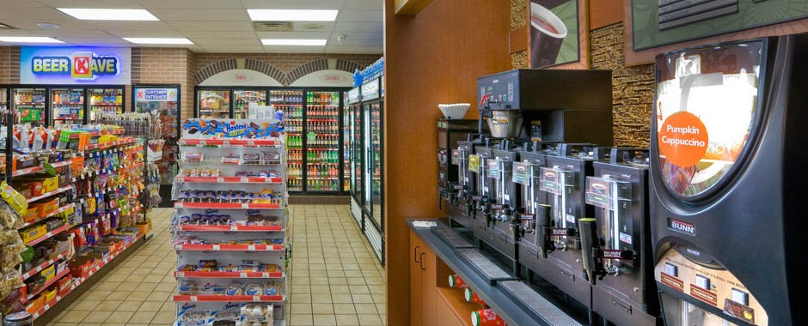
BAYES’ THEOREM – CONVIENCE STORES
They face “abandonment loss” when they discount food products.
Display food products in a manner that indicates a shortage of stock, it results in a “chance loss”
Analyze the conditions and reasons that promote the sale of food products

Slide 13
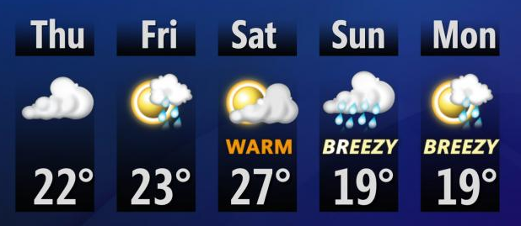



BAYES’ THEOREM & AI
AI is Intelligence displayed by machines.
Prediction based on previous data collected
e.g.
Reverse Probability:
$$P\left(A | R\right)=\frac{P\left(A\right).P(R|A)}{P(R)}$$
There are many concepts that we can use or merge with Bayes concept for prediction
$$A$$
$$B$$

Slide 14
References
Néstor.B.Y, Molina.C, “Bayes-Based Confidence Measure in Speech Recognition”, IEEE Signal Processing Letters, Vol. 12, No. 11, November 2005
Itakura.Y, Minazuki.A, “A study of the support system for displaying food products in convenience stores”, 9th IEEE/ACIS International Conference on Computer and Information Science, 2010
Al-Qaysi.I, Unland.R, Weihs.C, Branki.C, “Medical decision base Self-Organization System under uncertainty”
https://sites.google.com/site/bayeslegal/legal-cases-relevant-to-bayes
https://www.theguardian.com/law/2011/oct/02/formula-justice-bayes-theorem-miscarriage

Slide 15


